Slide 1



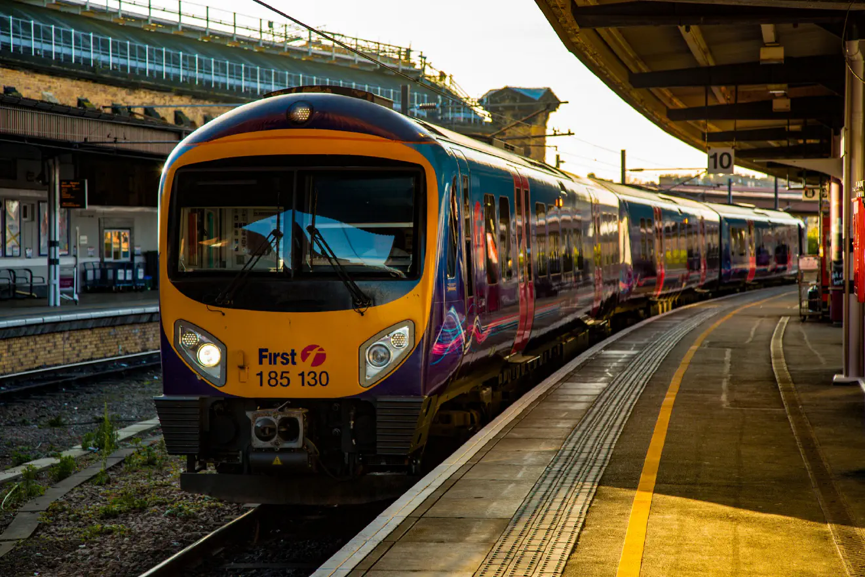



UK Train Stations
Presented By: Group 4

Slide 2
Team Members:
1- Ali Ashraf Ali
2- Asmaa Shokri Mohamed
3- Markos Awny Sadek
4- Mohammed Abdelmonem Fouad
5- Rasha Mohamed Salah
6- Sarah Mohsen Hassan

Slide 3
Intro:
This project delivers an interactive UK Trains Dashboard that analyzes station distribution, geographic patterns, and regional accessibility across the rail network. It supports transport planners, analysts, and decision-makers by offering mapping tools, regional comparisons, and location-based insights. Using the UK Train Stations dataset from Kaggle, the dashboard highlights current station data with filtering options to compare patterns across regions and over time.

Slide 4






Key Objectives:
Identify the most popular routes
Determine Peak Travel Times
Analyze Revenue from different ticket types & Classes
Diagnose on – time performance and contributing factors

Slide 5

Data Description:
Mock train ticket data for National Rail in the UK, from Jan to Apr 2024, including details on the type of ticket, the date & time for each journey, the departure & arrival stations, the ticket price, and more. The bulk of the data consists of one CSV file with the following columns:
Transaction ID: Unique identifier for an individual train ticket purchase
Date of Purchase : Date the ticket was purchased
Time of Purchase : Time the ticket was purchased
Purchase Type : Whether the ticket was purchased online or directly at a train station
Payment Method : Payment method used to purchase the ticket (Contactles Credit Card or Debit Card)
Railcard : Whether the passenger is a National Railcard holder (Adult Senior or Disabled) or not (None). Railcard holders get 1/3 off their ticket purchases.
Ticket Class : Seat class for the ticket (Standard or First)
Ticket Type : When you bought or can use the ticket. Advance tickets are 1/2 off and must be purchased at least a day prior to departure. Off-Peak tickets are 1/4 off and must be used outside of peak hours - (weekdays between 6-8am and 4-6pm). Anytime tickets are full price and can be bought and used at any time during the day.
Price : Final cost of the ticket
Departure Station : Station to board the train
Arrival Destination : Station to exit the train
Date of Journey : Date the train departed
Departure Time : Time the train departed
Arrival Time : Time the train was scheduled to arrive at its destination (can be on the day after departure)
Actual Arrival Time : Time the train arrived at its destination (can be on the day after departure)
Journey Status : Whether the train was on time delayed or cancelled
Reason for Delay : Reason for the delay or cancellation
Refund Request : Whether the passenger requested a refund after a delay or cancellation

Slide 6





Exploratory Data Analysis (EDA):
During the exploratory phase, the following insights and patterns were examined:
1. Network Coverage & Station Metrics
Total Stations: 2580
Countries Covered: England, Scotland, Wales
Unique CRS Codes: 100% availability
Geospatial Completeness: All stations include latitude & longitude
Key initial observation: The dataset provides full national coverage, enabling accurate mapping and accessibility analysis across the entire UK rail network.
2. Regional Station Distribution
Station counts vary significantly by region:
England: Highest concentration, especially around London and the South East
Scotland: Moderate distribution, with strong presence in central belt areas
Wales: Lower station density, with clusters around Cardiff and coastal towns
Insight: England dominates the rail network, indicating stronger transport infrastructure compared to Wales and rural Scotland.

Slide 7
Exploratory Data Analysis (EDA):
3. Urban vs Rural Accessibility
Urban hubs (London, Manchester, Birmingham): High station density within short distance
Rural regions: Sparse distribution, with larger gaps between stations
Coastal and remote areas: Noticeably limited coverage
Insight: The UK network is optimized for metropolitan mobility, while rural accessibility remains limited.
4. Geographic Cluster Analysis
Top departure stations :
Manchester Piccadilly
London Euston
Liverpool Lime street
Top Arrival stations :
Birmingham New Street
Liverpool Lime street
York
Insight: These clusters align with major population and economic centres, reinforcing the link between transport networks and urban development.

Slide 8
Exploratory Data Analysis (EDA):
5. Station Naming & Coding Patterns
CRS codes: Typically 3-letter abbreviations tied to station names
Duplicate name patterns: Minimal, with unique naming conventions
Longest station names: Found mostly in Wales due to Welsh spelling
Insight: Standard naming and coding enhances dataset usability and reduces ambiguity in route-level mapping.
.
6. Spatial Coverage Across the UK
Strong concentration: South East, Midlands, and North West
Moderate spread: Scotland’s central belt
Low coverage: Mid-Wales, Highlands, and remote coastal areas
Insight: Coverage imbalance highlights transport inequality and potential growth areas for future rail investment.

Slide 9
Analysis and Insights:
concentration aligns heavily with economic hubs, suggesting network development follows population density.
Rural regions show accessibility gaps, indicating potential areas for transportation improvement.
Geographic clusters support strong intercity connections but may leave remote regions under-served.
Station coding and naming consistency makes the dataset reliable for mapping, AI routing models, and GIS work.The uneven regional distribution highlights opportunities for expanding services, especially in Wales and northern Scotland.

Slide 10
Limitations:
The dataset includes station locations only—no timetable, ridership, delay, or operational data.
No demographic or socioeconomic data is included to link accessibility with population needs.
The dataset does not capture temporary closures, new station openings, or planned future expansions.
Only static geographic data is provided—no temporal or historical trends.
Accuracy depends entirely on the dataset’s completeness at the time of upload.

Slide 11
Conclusion:
The dashboard provides a comprehensive overview of the UK rail network’s geographic structure and accessibility. It enables quick identification of:
High-density station regions
Rural coverage gaps
Urban transport hubs
Regional disparities in rail availability
Insights from this analysis can support:
Transport planning and infrastructure expansion
Accessibility studies
GIS modelling and spatial network analysis
Policy decisions related to regional mobility
Future enhancements may include:
Integrating ridership / passenger demand data
Adding timetable and delay performance data
Incorporating demographic layers for accessibility modelling
Building predictive models for future network expansion

